Slide 1
BIOINFORMATICS TRAINING MODULE 1: INTRODUCTION TO NEXT-GENERATION SEQUENCING
DR. AYORINDE O. AFOLAYAN
GHRU Bioinformatician
University of Ibadan, Nigeria

Slide 2
SEQUENCING
DNA sequencing is the process of determining the nucleic acid sequence – the order of nucleotides in DNA. It includes any method or technology that is used to determine the order of the four bases: adenine, guanine, cytosine, and thymine.
Why?

Slide 3
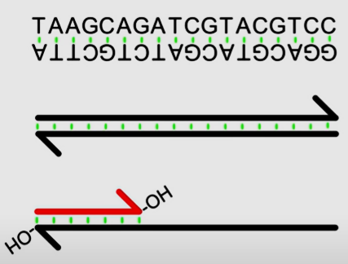
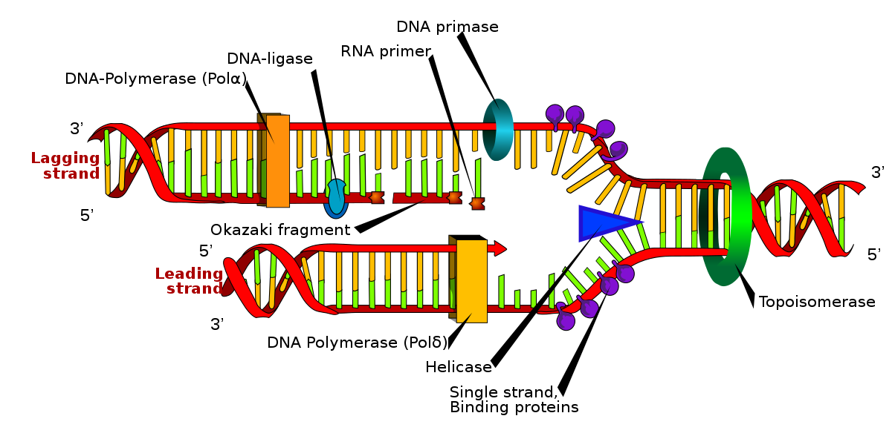
A Primer on DNA
Deoxyribonucleic acid (DNA) is made of two anti-parallel strands
Strands can be separated and annealed with matching strands.
DNA Sequencing: the process of determining the nucleic acid sequence – the order of nucleotides in DNA.
Genome.

Slide 4
SEQUENCING METHODOLOGIES
Traditional Sequencing
Next-generation Sequencing
Sequencing by Synthesis
Oxford Nanopore
Pacific Biosciences

Slide 5
Human Genome Project
The human genome project
Spurred the development of cheaper sequencing
Is 20-year, $3 billion USD effort
Was completed in 2003.
Lowered cost to $100 million per genome
Used Sanger sequencing
Notes:
The Human Genome Project was the international research effort to determine the DNA sequence of the entire human genome

Slide 6
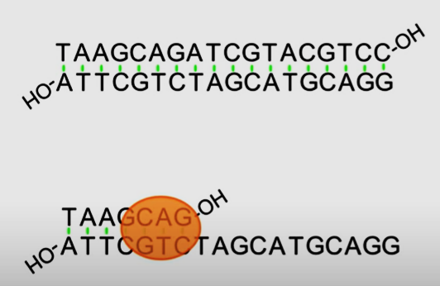
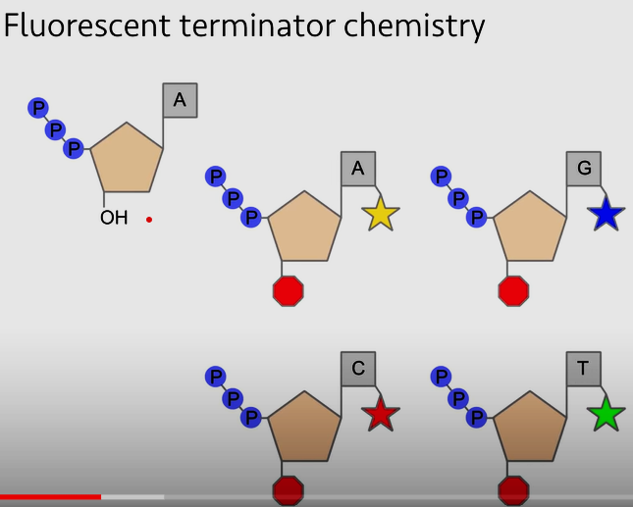
Sanger Sequencing
Denature
Add primers
Add dideoxyribonucleic acid.
Source: https://www.youtube.com/watch?v=mI0Fo9kaWqo

Slide 7
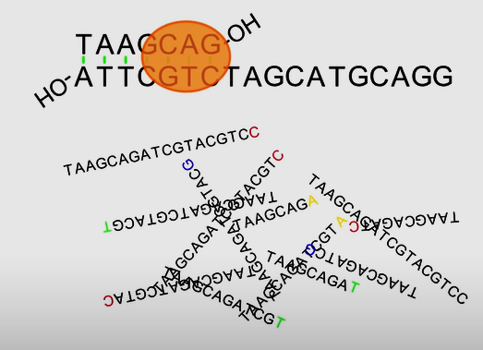
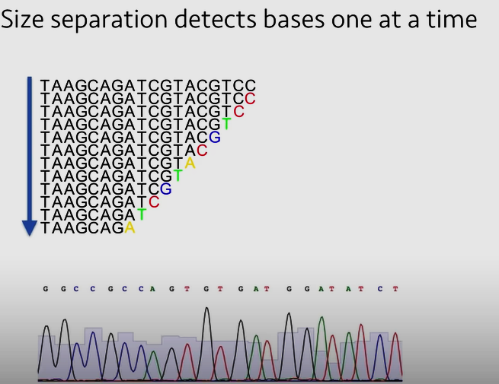
Sanger Sequencing
The Sequencer Separates sequences into sizes
The order of bases is determined by the size separation
Source: https://www.youtube.com/watch?v=mI0Fo9kaWqo

Slide 8
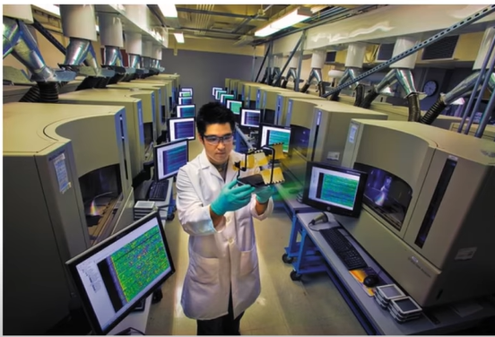
Limitations of Sanger Sequencing
Low throughput: Can only sequence up to 1 million bases per day (700 base reads)
Human genome is 6 billion bases: 7x coverage, 100 years on one sequencer.
Human genome project accomplished with several sequencers.
https://www.nature.com/articles/526029a.pdf

Slide 9
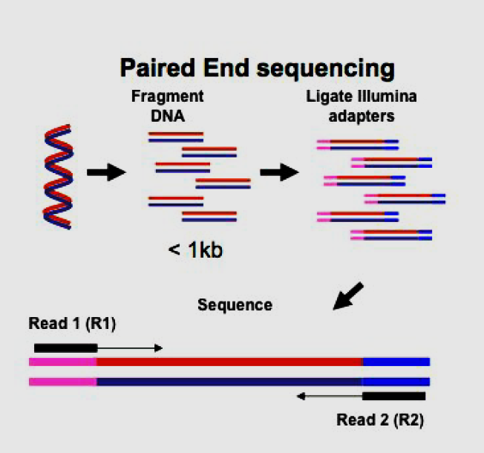
INTRODUCTION TO NEXT-GENERATION SEQUENCING
Next generation or high throughput sequencing involves massively parallel sequencing of small fragments of DNA that have been generated from an original nucleic acid source. This can be genomic DNA, PCR amplicons or cDNA generated from RNA.

Slide 10
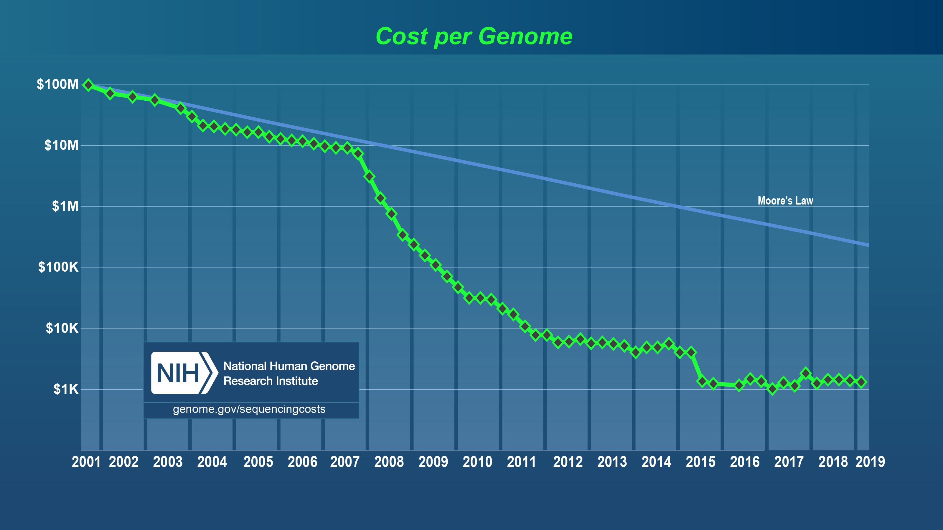
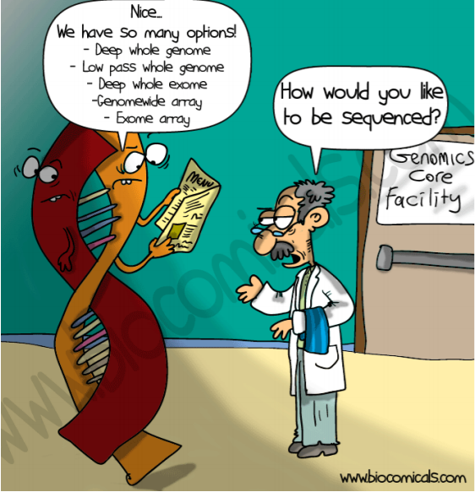
Advent of Next-generation Sequencing
Source: https://upload.wikimedia.org/wikipedia/commons/0/01/Cost_per_Genome.png

Slide 11
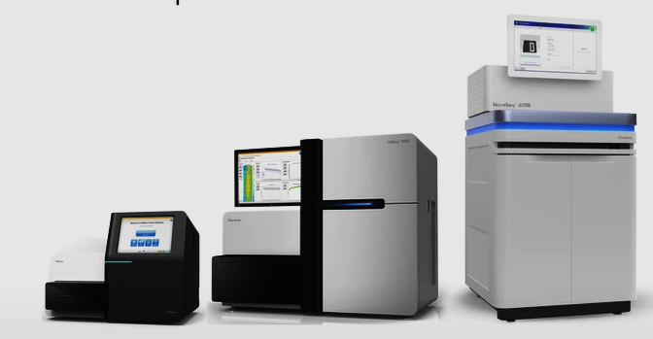
Next-generation sequencers
Illumina
 | MiSeq | HiSeq | NovaSeq | Sanger
Reads (millions) | 30 | 3000 | 13000 | 0.0004
Gigabases/day | 7 | 500 | 4000 | 0.001

Slide 12
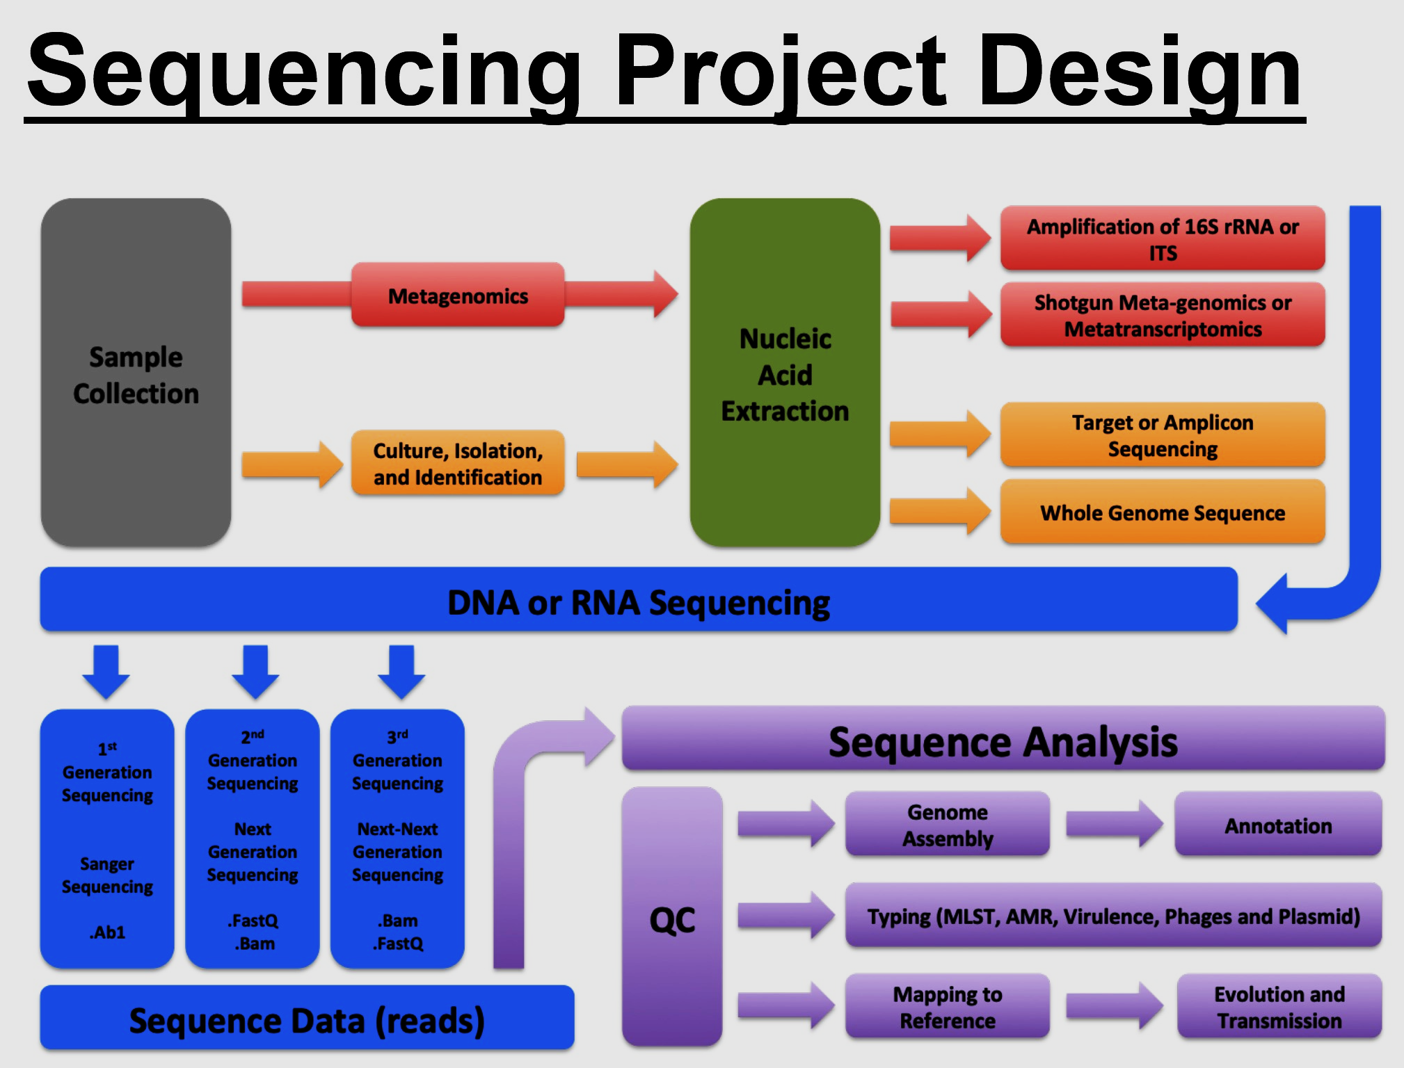
Sequences need context. METADATA is very important.

Slide 13
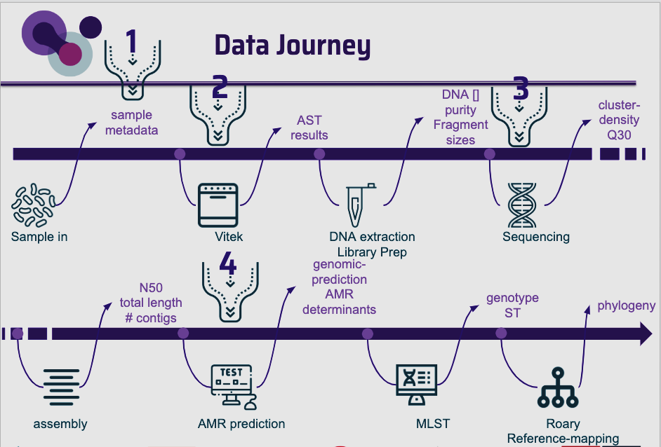

Slide 14
NGS Terminologies: DNA Extraction
DNA extraction: Genomic DNA (gDNA) is found in the nucleus of a cell. In order for health personnel/research scientist to be able to sequence the DNA, it must be first taken out of the cell. For gDNA, lyse the cells harshly (chemical or mechanical) to release all the contents and extract the gDNA.

Slide 15
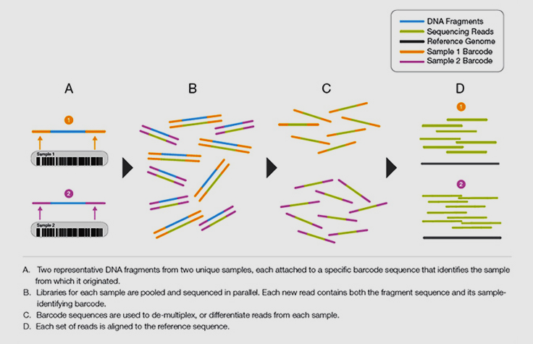
NGS Technologies: Library Preparation
Library: A collection of DNA or cDNA fragments prepared for sequencing by a performing a series of enzymatic steps
Multiplexing: A process by which unique short DNA sequences, or “indexes,” are added to each DNA fragment during library preparation.
Barcode/Index: A short unique sequence through which you can identify different samples pooled into a single library.
Source: https://www.illumina.com/science/technology/next-generation-sequencing/beginners/glossary.html; https://www.seqme.eu/en/magazine/glossary

Slide 16
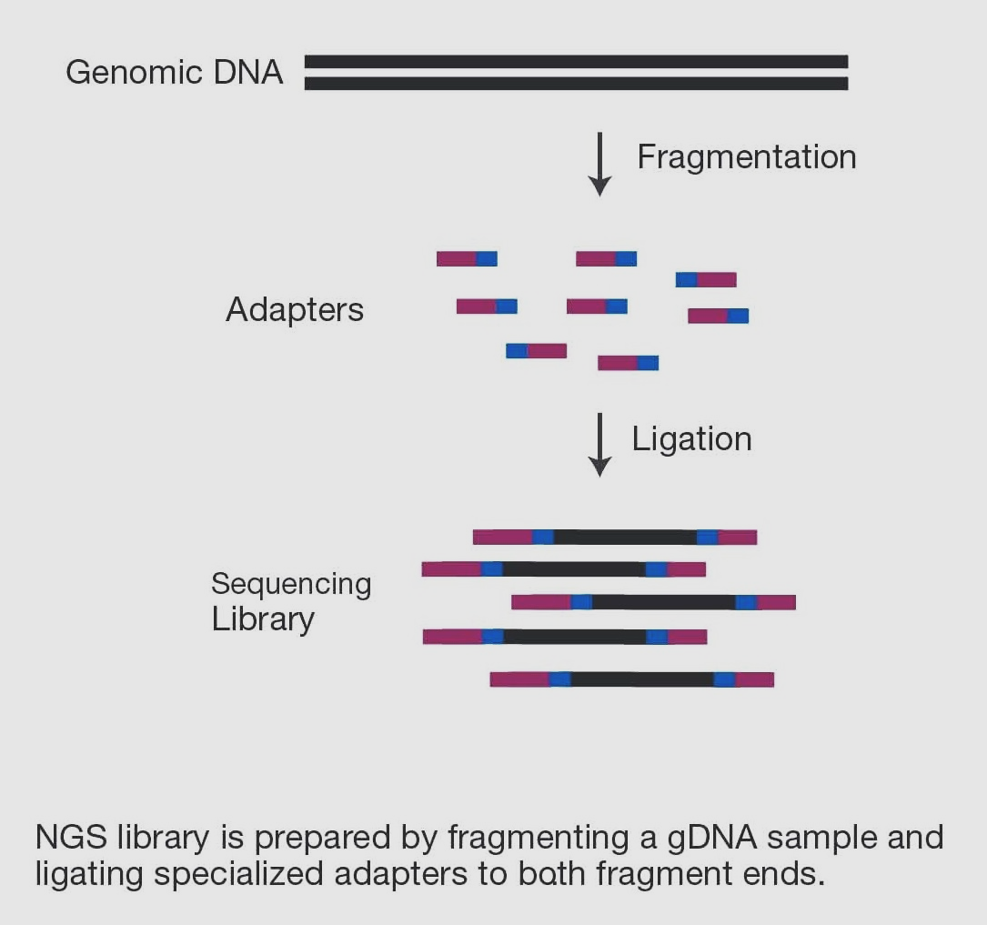

Slide 17
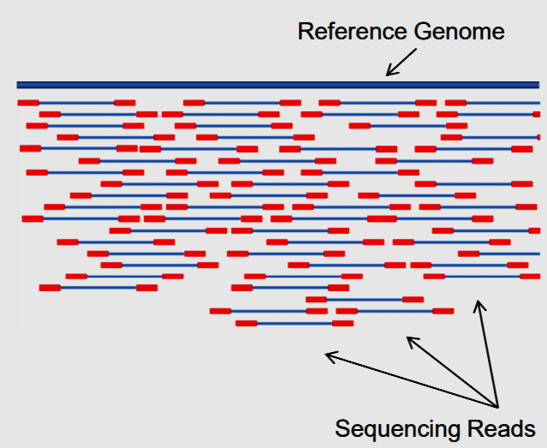
NGS Terminologies: Library Preparation
Fragment: A short stretch of nucleic acid resulting from the fragmentation of longer stretches and sequenced. The required size of a fragment is specific to the type of experiment and sequencer possibilities.
Adapters: Short sequence-specific oligos ligated to the 5ʹ and 3′ends of each DNA fragment in a sequencing library as part of NGS library preparation.

Slide 18
The sequencing-ready fragment (paired-end)
Index 2
(with own
primer binding site)
Index 1
(with own primer
binding site)
Insert
P5
attachment site
for flow cell
P7
attachment site
for flow cell
Adapter 1
includes binding site
for read 1 sequencing
primer
Adapter 2
includes binding site
for read 2 sequencing
primer
18

Slide 19
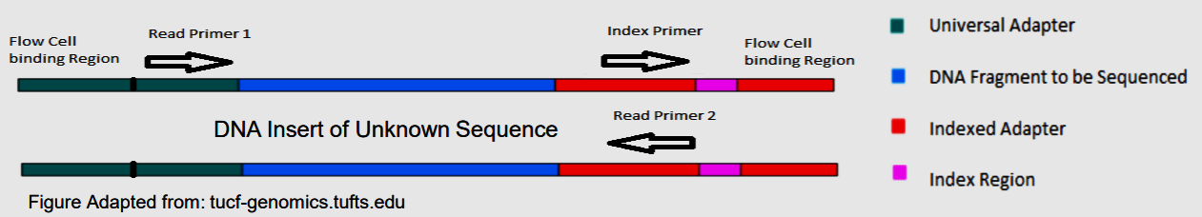
Library Preparation

Slide 20
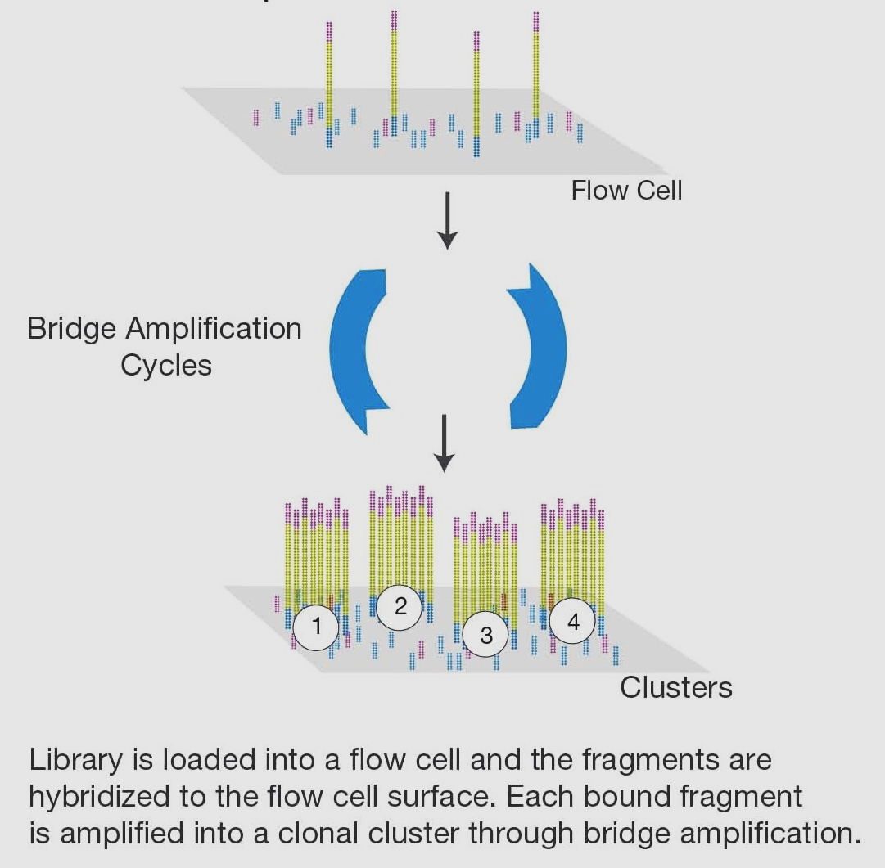

NGS Terminologies: Sequencing
Flowcell: Flow cell is a channel for adsorbing mobile DNA fragments, and it's also a core sequencing reactor vessel — all the sequencing happens here.

Slide 21
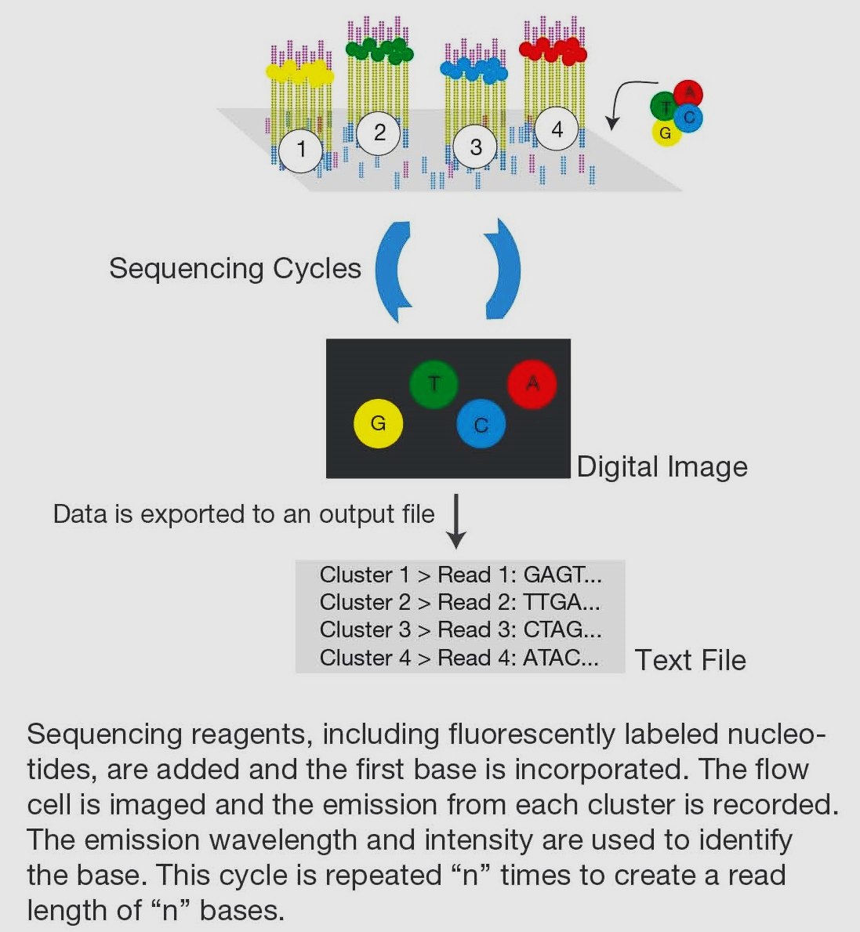
NGS Terminologies: Sequencing
What massively parallel sequencing means?
A sequencing platform can collect information from many millions of reaction centres simultaneously, thus sequencing many millions of DNA molecules in parallel.
https://www.cd-genomics.com/blog/principle-and-workflow-of-illumina-next-generation-sequencing/

Slide 22
Next generation or high throughput sequencing involves massively parallel sequencing of small fragments of DNA that have been generated from an original nucleic acid source. This can be genomic DNA, PCR amplicons or cDNA generated from RNA.

Slide 23
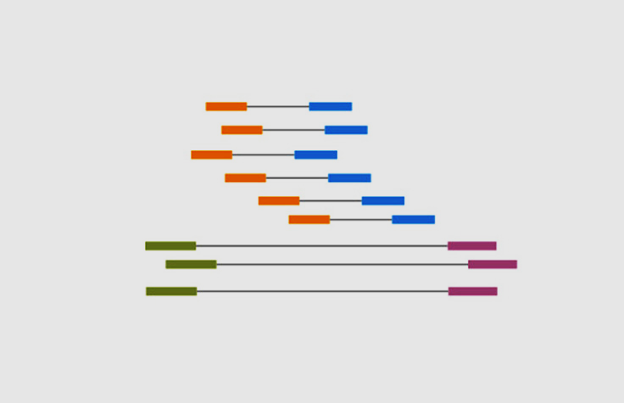
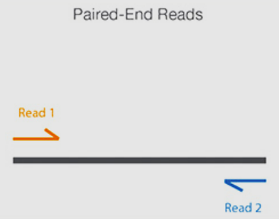
NGS Terminologies: Sequencing
Read: Data output from the analysis of a single fragment (sequence).
Paired-End Read: A method of reading a fragment where the fragment is first read from one end and then from the other.
Read length: refers to the number of base pairs (bp) sequenced from a DNA fragment. Why is this important?
Notes:
Contigs: A stretch of continuous sequence, in silico, generated by aligning overlapping sequencing reads.

Slide 24
NGS Terminologies: Sequencing
Basecalling: This is the (computational) process of converting raw electrical signal to nucleotide sequence.
Run: A single process cycle of the sequencer from the start-up up to obtaining raw data
Genome: A genome is the complete set of genetic information in an organism. It provides all of the information the organism requires to function.
Source: https://www.illumina.com/science/technology/next-generation-sequencing/beginners/glossary.html; https://www.seqme.eu/en/magazine/glossary

Slide 25
NGS Terminologies: Sequencing
Depth/Coverage – The number of reads that spans a given DNA sequence of interest. This is commonly expressed in terms of “Yx” where “Y” is the number of reads and “x” is the unit reflecting the depth of coverage metric (i.e. 5x, 10x, 20x, 100x)
Deep Sequencing: The amount of sequencing a given sample requires to achieve a certain depth of coverage. This is frequently expressed as the number of reads a sample requires (ex. 40 million reads, 80 million reads) or the number of bases of sequencing a sample requires (ex. 4 gigabases, 100 megabases).
Notes:
Read depth e.g For example, a whole genome sequenced at 30× coverage means that, on average, each base in the genome was sequenced 30 times. At higher levels of coverage, base calls can be made with a higher degree of confidence. Coverage (or depth) in DNA sequencing is the number of unique reads that include a given nucleotide in the reconstructed sequence
Adapters cont’d: The adapters are complementary to the short sequences present on the surface of Illumina flow cells.
Read length: Because long reads allow for more sequence overlap, they are useful for de novo assembly and resolving repetitive areas of the genome with greater confidence.

Slide 26
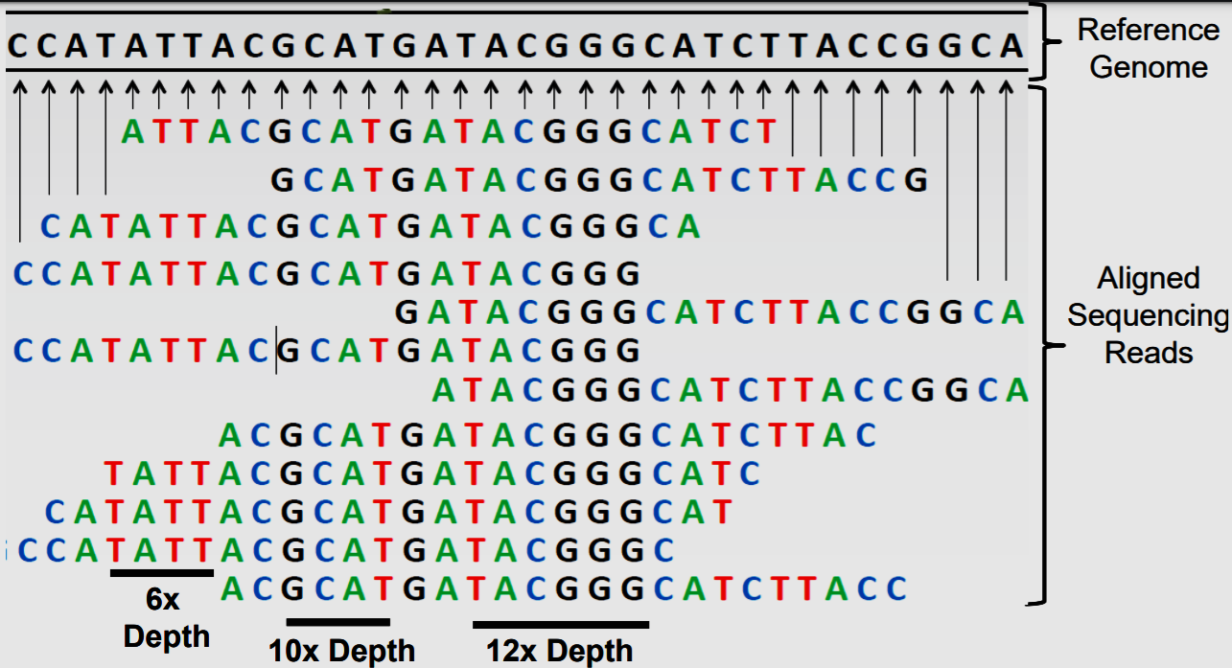
Read Depth/Coverage
https://www.agilent.com/cs/library/eseminars/Public/Next%20Generation%20Sequencing%20101.pdf

Slide 27
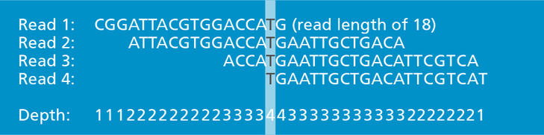
Read Depth/Coverage

Slide 28

Base call qualities and PHRED Scores
PHRED Scores (or Q values) are the measure of base call quality:
$$Q=−10 \log_{10} P$$
$$\text{P} \text{is} \text{the} \text{p}\text{robability} \text{of} \text{incorrect} \text{base} \text{call}\text{s}$$
PHRED Score | Probability of incorrect base calls (P) |  | Base call accuracy
10 | 0.1 | 1 in 10 | 90%
20 | 0.01 | 1 in 100 | 99%
30 | 0.001 | 1 in 1000 | 99.9%
40 | 0.0001 | 1 in 10,000 | 99.99%
50 | 0.00001 | 1 in 100,000 | 99.999%
60 | 0.000001 | 1 in 1,000,000 | 99.9999%
Raw Data QC
modified from Wikipedia.org
28

Slide 29
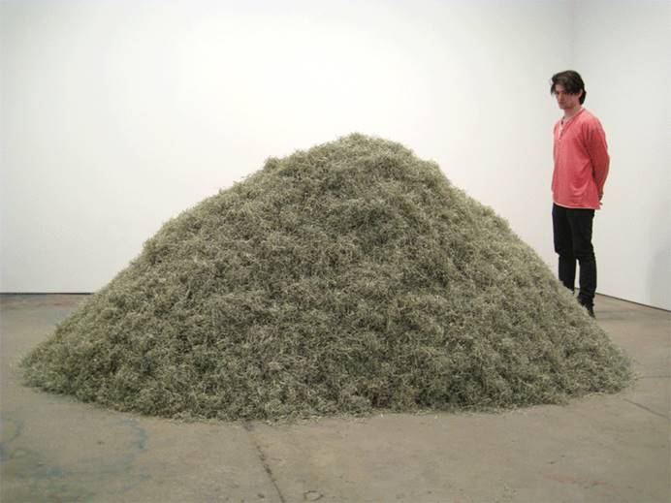
Reference-based (mapping)
Reference-free (de novo assembly)

Slide 30
De novo assembly
a
I HATE B
I HATE B
DNA MOLE
TE BEING
O MUCH T
TE BEING
NG A DNA
MOLECULE
NG A DNA
DNA MOLE
CH TO RE
DNA MOLE
MOLECULE
MOLECULE
EMEMBER!
assembled
reads
ULE. THE
assembled
reads
ULE. THE
I HATE B
THERE IS
IS SO MU
THERE IS
IS SO MU
IS SO MU
O MUCH T
O MUCH T
TE BEING
CH TO RE
CH TO RE
ULE. THE
EMEMBER!
THERE IS
EMEMBER!
NG A DNA
I HATE BEING A DNA MOLECULE. THERE IS SO MUCH TO REMEMBER!
consensus
12.10.2017
De novo Assembly
30

Slide 31
NGS Terminologies: Post-Sequencing
Ideally, de novo Assembly in WGS is the reconstruction of a target sequence based on shotgun reads, which are randomly distributed along the target molecule. For this, the target molecule has to be over-sampled by the shotgun-reads (overlapping reads).
An assembly consists of:
4
3
2
1
1
shotgun reads
base call qualities
possibly paired-end information
2
contigs
alignment of reads
consensus sequences
3
„jumping reads“
paired reads with long insert sizes
4
scaffolds
contig order and orientation
gap lengths
FASTQ
BAM
FASTA
FASTQ
FASTA
De novo Assembly
31
Notes:
Assembly of fragment sequences into higher order structures based on their overlap and reference sequence, where appropriate.

Slide 32






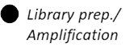

The DNA Sequencing Workflow Again

Slide 33
Bioinformatics is all about File Formats
Raw reads
Raw data (FAST5 and FASTQ)
Alignment (SAM/BAM/CRAM)
Reference genomes (FASTA)
Annotation files (GTF/GFF/BED)
Result files (VCF/TSV/BCF/gVCF)
QC Assessment
Filtered read
Alignment
BAM file
Detection
Result file
Filtering
Answer

Slide 34
Sequence File Formats
A FASTQ file normally has four lines per sequence fragment.
Line 1 begins with a '@' character and is followed by a sequence identifier and an optional description (like a FASTA title line).
Line 2 contains the sequence as letters that represent the nucleotides.
Line 3 begins with a '+' character and is optionally followed by the same sequence identifier (and any description) again.
Line 4 encodes the quality values for the sequence in Line 2, and contains the same number of symbols as letters in the sequence.
34

Slide 35
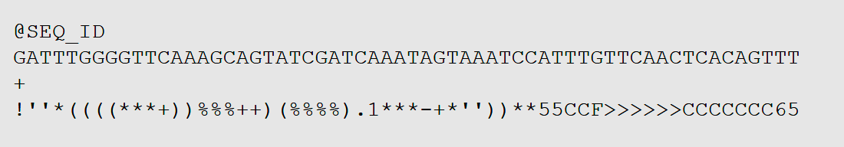
Example of a FASTQ file
35

Slide 36
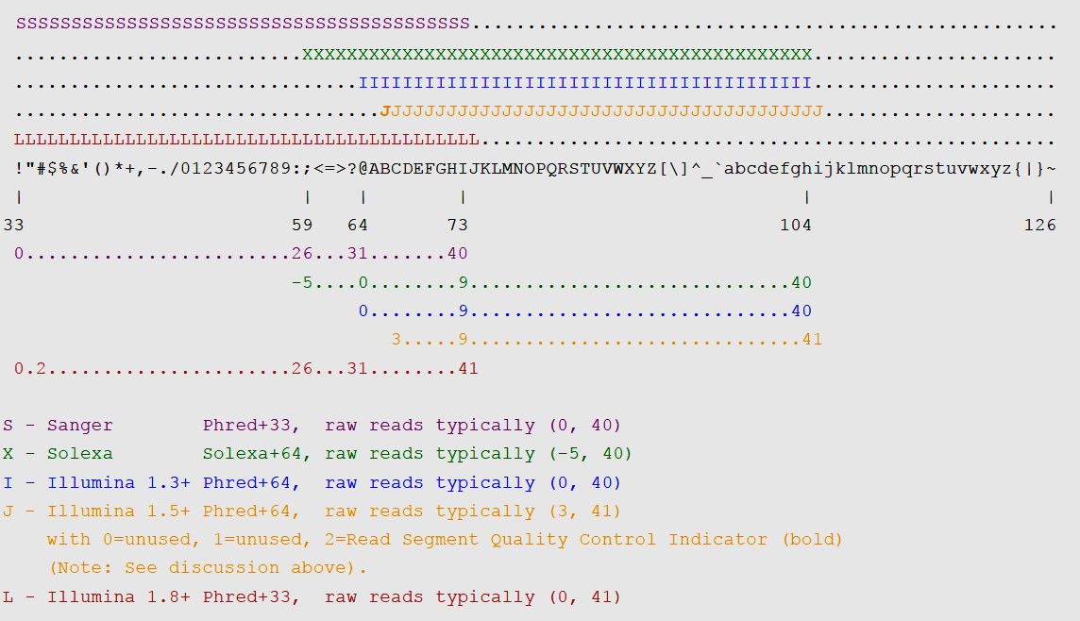
FASTQ QUALITY METRICS
36

Slide 37
Videos and links
Evolution of NGS: https://www.youtube.com/watch?v=jFCD8Q6qSTM&t=176s
Illumina Sequencing: https://www.youtube.com/watch?v=fCd6B5HRaZ8
Sanger Sequencing: https://www.youtube.com/watch?v=Jnk_4Maf5Fk

Slide 38

Finish.

Slide 39

THANK YOU

